Slide 1


♪
♫
JAVA PROJECT • ACADEMIC SUBMISSION • 2026
Music Playlist
& Listening Stats
Manager
♩
NOW PLAYING
Your Project Demo
♪
A Java-based console application for organising playlists, tracking play counts, and analysing listening habits.
STUDENT NAMES
ROLL NUMBERS
BATCH
Boga Shashank • Yarlagadda Druveen
2620040175 • 2620030528
15
Notes:
- Introduce yourself and your project partner by name and roll number.
- Name your faculty guide and thank them for guidance.
- State this is a Java-based Music Playlist Manager built as our academic project.
- Mention it is a console application — no UI, no internet, pure OOP.
- Set expectation: 13 slides covering problem, design, code, output, and roadmap.

Slide 2






♫
01 / 15 — INTRODUCTION
Introduction
Music is now an inseparable part of daily life, and so are the playlists we curate for every mood — from gym sessions to late-night study marathons. The Music Playlist and Listening Stats Manager is a console-based Java application designed to bring structure to this listening experience. It lets users organise their favourite tracks into named playlists, mark them as played, and instantly see meaningful statistics about what they actually listen to — not just what they think they listen to.
PLAYLIST CARD
● Purpose — A self-contained Java CLI app that models playlists, songs, and listening behaviour in pure OOP style.
● Scope — Covers playlist creation, song CRUD, play tracking, favorites, search/filter, and live statistics — no external database needed.
● Audience — Students, music enthusiasts, and developers who want a lightweight, dependency-free music organiser.
MIXTAPE
FOCUS
CHILL VIBES
Chill Vibes • 3 songs • 12m 04s
▶
NOW PLAYING
PLAYLISTS
STATS
FAVORITES
Music Playlist & Listening Stats Manager
02 / 15
Notes:
- Set context: music is part of daily life, playlists are how we curate moods.
- Explain the app's role: bring structure to listening with playlists + stats.
- Stress that it is console-based, dependency-free Java — runs anywhere.
- Mention the three pillars: Purpose, Scope, Audience.

Slide 3


♪
02 / 15 — PROBLEM STATEMENT
The Problem
“
Despite streaming apps offering vast libraries, listeners still lack a simple, offline way to organise their own music, track which songs they actually play, and reflect on their listening patterns. Most apps show what is available, not what the user actually consumes — there is no personalised listening dashboard for a personal collection.
♩
♪
◆
♡
Scattered Library
No Listening Insights
Forgettable Favorites
Songs live across multiple apps and folders with no unified view. Users cannot quickly find a track they remember only vaguely.
Streaming dashboards aggregate anonymous data; users get little insight into their own play-count, top artists, or total listening time.
Without an explicit favorites list and play history, songs you love get buried under new additions and are easily forgotten.
Music Playlist & Listening Stats Manager
03 / 15
Notes:
- Open with the core problem: no offline way to organise and reflect on personal listening.
- Streaming apps show what is available, not what you actually consume.
- Walk through three sub-problems: scattered library, no insights, forgettable favorites.
- Tee up the proposed system on the next slide.

Slide 4

♪
03 / 15 — OBJECTIVES
Project Objectives
Six concrete goals that define the scope and deliverables of this Java project.
01
Model Music Data in OOP
02
Enable Playlist CRUD
03
Track Listening Behaviour
Design Song and Playlist classes with encapsulated fields, constructors, and helper methods for clean code reuse.
Allow users to create, list, add to, and remove songs from multiple named playlists from a single menu.
Increment play counts whenever a song is played and persist that count inside the song object for later analysis.
04
Compute Listening Statistics
05
Search and Filter Library
06
Mark and View Favorites
Generate per-playlist and global stats: total songs, total plays, total listening time, most-played song, and top artists.
Let users search by title or artist keyword across all playlists and sort playlists by descending play count.
Allow toggling a favorite flag on any song and expose a dedicated view that lists only favorited tracks across playlists.
♩
Music Playlist & Listening Stats Manager
04 / 15
Notes:
- Walk through all six objectives quickly — these define project scope.
- Emphasise the OOP-first design (objective 01) as the foundation.
- Highlight analytics focus — objectives 03 and 04 are the differentiator.
- Mention search/filter and favorites as the user-facing polish layer.

Slide 5


♪
04 / 15 — EXISTING SYSTEM
How It Works Today
A look at the solutions listeners currently rely on and where each falls short.
Spotify
YouTube Music
F
Local Files / Manual Lists
STREAMING PLATFORM
VIDEO-DRIVEN MUSIC
LOCAL STORAGE
● Requires active internet and a paid premium account for offline listening.
● Aggregated statistics only; no per-song play counter you can manually trigger.
● Cannot combine songs from outside its catalog into a single unified playlist.
● Privacy concerns — listening history is stored on third-party servers.
● Songs disappear when videos are removed or copyright changes hands.
● Ad interruptions skew the listening and play-count experience.
● No unified dashboard for personal library statistics across playlists.
● Heavy on resources — a video player is overkill for audio-only listening.
● Maintaining a written or spreadsheet list is tedious and error-prone.
● No automatic play tracking — users must remember or note each play.
● No searching, sorting, or statistics without manual formulas.
● Hard to share, back up, or visualise listening trends over time.
GAP: A LIGHTWEIGHT, OFFLINE, JAVA-BASED SOLUTION THAT COMBINES ORGANISATION + ANALYTICS IN A SINGLE APP.
Music Playlist & Listening Stats Manager
05 / 15
Notes:
- Three current solutions: Spotify, YouTube Music, and manual local files.
- Common pain point: no offline, lightweight, personal listening dashboard.
- Spotify needs internet + premium; YouTube Music is video-heavy and unstable.
- Manual lists are tedious and have no automatic tracking.
- Highlight the gap statement to tee up the proposed system.

Slide 6


♪
05 / 15 — PROPOSED SYSTEM
Our Solution
The proposed Music Playlist and Listening Stats Manager is a console-based Java application that rethinks personal music management. It stores songs and playlists as in-memory objects using clean OOP principles, tracks every play, and computes statistics on demand. There is no internet dependency, no third-party login, and no setup beyond a Java 11+ runtime — it just runs.
⚡
CORE FEATURES
01
Multi-Playlist Management
Create and switch between unlimited playlists.
02
Add / Remove Songs
♪
Unified Playlist Engine
Songs carry ID, title, artist, duration metadata.
Multiple named playlists, each holding any number of songs with title, artist, duration, and play count.
03
Play Tracking
Each play increments the song's play count atomically.
▦
Live Listening Analytics
04
Search & Favorites
Per-playlist and global stats computed on demand — total plays, total listening time, most-played song, top artists.
Filter by keyword, mark favorites, sort by plays.
5 sample songs • 2 demo playlists • 21 simulated plays
♫
♥
Personalisation Layer
Mark favorites, search the entire library, and sort playlists by play count to surface what you actually listen to.
Music Playlist & Listening Stats Manager
06 / 15
Notes:
• Emphasise the offline, dependency-free nature of the app.
• Call out OOP-first design — Song + Playlist classes, in-memory only.
• Analytics-on-demand is the differentiator vs streaming dashboards.
• Mention the 3 pillars: Unified Playlist Engine, Live Analytics, Personalisation.
• Demo seed: 5 songs, 2 playlists, 21 simulated plays.

Slide 7
♫
06 / 15 — SYSTEM ARCHITECTURE
Architecture Overview
A three-layer design — User Interface, Application Logic, and Data Model — built entirely in pure Java.
✦
PRESENTATION
User Interface Layer
A text-based menu loop that reads user choices via java.util.Scanner and prints formatted responses to the terminal.
APPLICATION
▦
Business Logic Layer
Holds all the operations — create, add, remove, play, compute stats, search, sort, toggle favorites. Pure Java methods, no I/O.
▦
DATA
Model Layer
Two POJO classes (Song and Playlist) store the entire runtime state in memory. Sample data is seeded on startup.
Music Playlist & Listening Stats Manager
07 / 15
Notes:
• Walk top-down: Presentation → Application → Data.
• Presentation = console menu via java.util.Scanner.
• Application = pure Java methods, no I/O dependencies.
• Data = 2 POJOs in memory; sample data seeded on startup.
• Callout: std-lib only, JDK 11+, no external JARs.

Slide 8



♪
07 / 15 — FUNCTIONALITIES
What It Can Do
Four menu options exposed through a switch statement in main() — covering playlist analysis, genre matrix, streak calculation, and exit. Powered by four core Java techniques.
MENU OPTIONS
▦
01
▦
02
✦
03
⏻
04
Analyze Play Counts
Genre Breakdown Matrix
Superfan Streak
Exit
Read N track play counts into a 1D array, sum the total, and find the most-played track.
Build a 4×3 2D matrix of weekly streams across Pop, Rock, and Hip-Hop; compute per-genre totals.
Take a consecutive-days streak and compute the Superfan Multiplier via a recursive factorial.
Print a closing message, close the Scanner, and end the program cleanly.
UNDERLYING JAVA TECHNIQUES
▦
T1
▦
T2
▶
T3
☎
T4
1D Arrays
2D Arrays
Recursion
Switch + Scanner
♫
int[] playCounts stores per-track streams; iterated for total + max.
int[4][3] genreMatrix models weeks × genres; accessed via nested for-loops.
calculateStreakMultiplier(n) = n × f(n−1), base case n == 0 returns 1 (factorial).
switch(choice) dispatches the 4 cases; Scanner reads all user inputs from stdin.
Music Playlist & Listening Stats Manager
08 / 15
Notes:
• Four menu options dispatched by a switch on the user's integer choice.
• Option 1 — 1D array of play counts; Option 2 — 2D genre matrix; Option 3 — recursive factorial.
• Option 4 — graceful exit; default case rejects invalid choices.
• Four supporting techniques: 1D arrays, 2D arrays, recursion, switch+Scanner.
• Each menu option maps directly to one case block in Main.java.

Slide 9
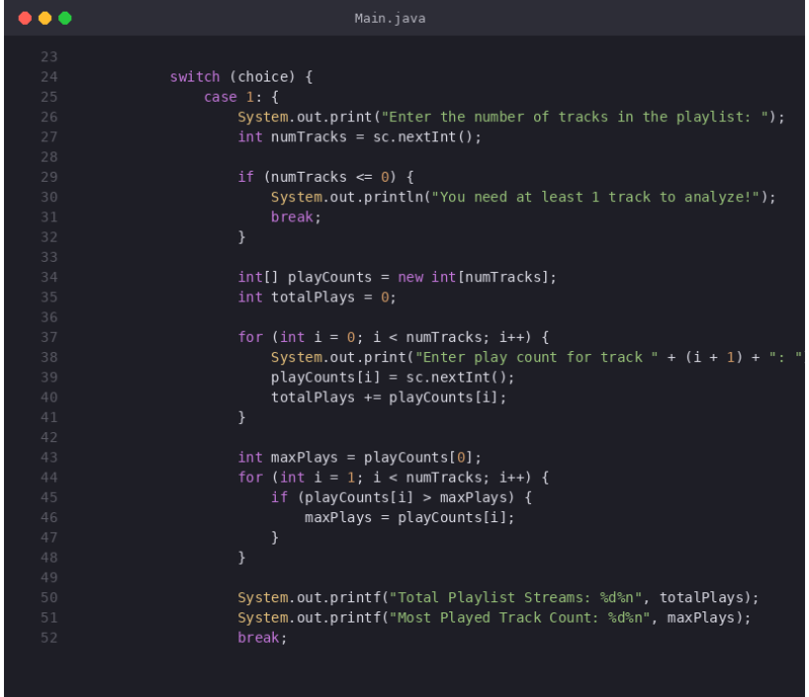
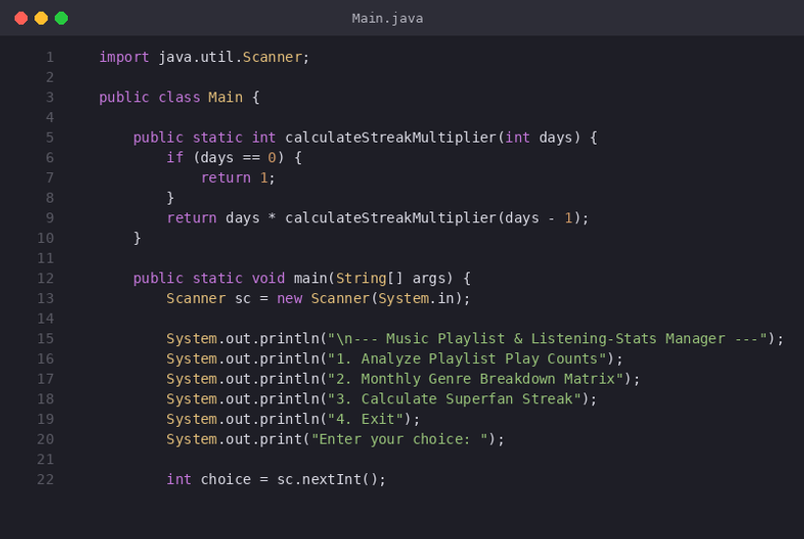
♪
08 / 15 — IMPLEMENTATION (PART 1 OF 2)
Java Code — Recursion & Play Counts
The calculateStreakMultiplier() recursive method, the main() entry, and Case 1 — analyzing play counts with a 1D array.
02 — PLAY COUNTS (Case 1)
01 — RECURSION + MAIN
calculateStreakMultiplier() recursive method + main() + 4-option menu + switch
Case 1 — analyze playlist play counts via 1D array + total + max-finding loop
Music Playlist & Listening Stats Manager
09 / 15
Notes:
• calculateStreakMultiplier(int days) recurses with days * f(days-1), base case days == 0 returns 1.
• main() opens a Scanner, prints the 4-option menu, dispatches via switch on user choice.
• Case 1 reads N tracks into an int[] playCounts array, sums total plays, and finds the max.
• Simple, dependency-free Java — no external JARs, runs with `java Main.java` on JDK 11+.
• Sets up the heavier 2D-array logic shown on the next slide.

Slide 10
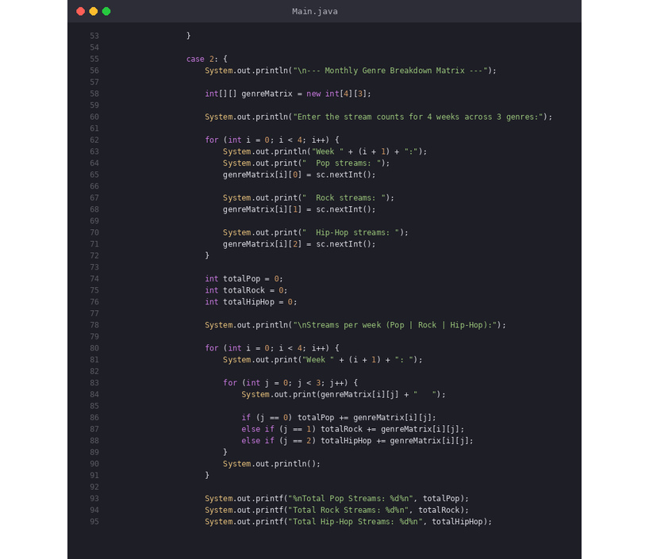
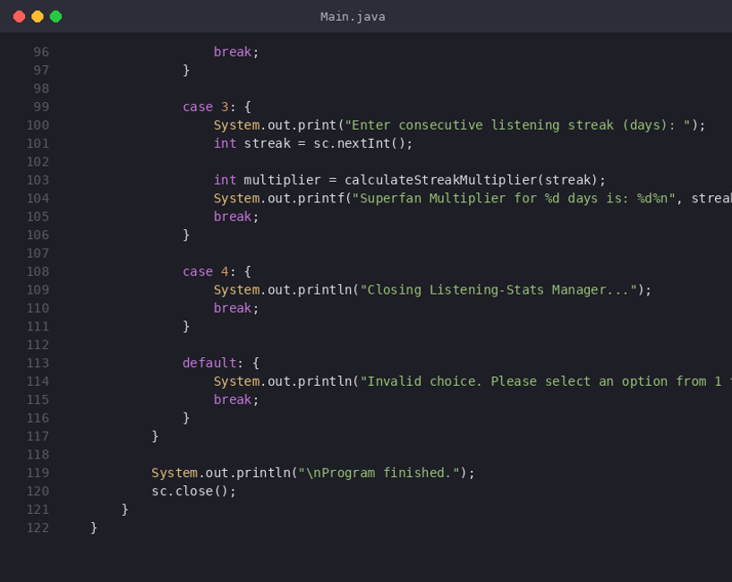
08 / 15 — IMPLEMENTATION (PART 2 OF 2)
Java Code — 2D Matrix, Streak & Exit
2D
switch
Case 2 builds a int[4][3] matrix of weekly genre streams; Case 3 calls the recursive multiplier; Case 4 closes the app.
▦
array
✦
Nested loops
☎
case
★
GitHub Ready
03 — GENRE MATRIX (Case 2)
04 — STREAK + EXIT (Case 3 & 4)
♫
Case 2 — 4×3 genre matrix + nested loops + per-column totals
Case 3 — recursive streak multiplier call + Case 4 — exit + default fallback
Music Playlist & Listening Stats Manager
10 / 15
Notes:
• Case 2 declares int[4][3] — 4 weeks (rows) × 3 genres (columns: Pop, Rock, Hip-Hop).
• Nested for-loops both read input and accumulate per-genre column totals.
• Case 3 invokes the recursive calculateStreakMultiplier(days) — for 5 days returns 120.
• Case 4 prints a closing message; default rejects invalid choices 5+.
• Program closes Scanner and prints "Program finished." before exit.

Slide 11
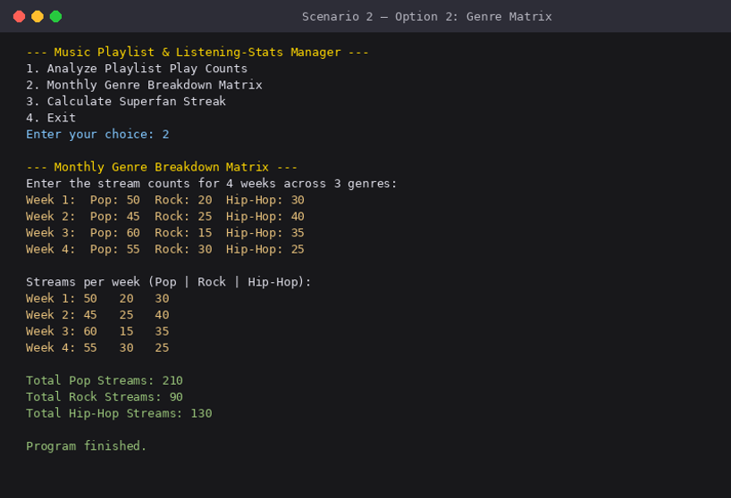
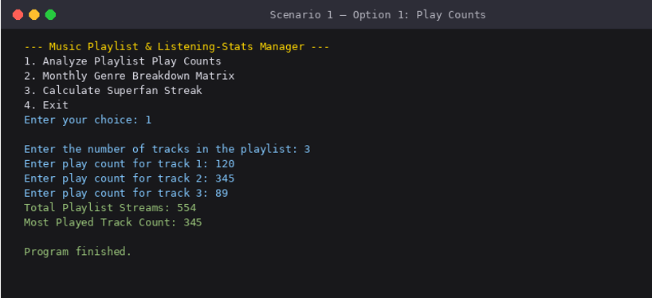
♪
09 / 15 — OUTPUT (PART 1 OF 2)
Program Output — Play Counts & Genre Matrix
Captured from a java Main.java run — Scenario 1 analyzes a 3-track playlist, Scenario 2 fills a 4-week × 3-genre matrix.
✦
Console output
✦
Scenario 1
✦
Scenario 2
✓
Verified run
01 — SCENARIO 1 (Option 1)
02 — SCENARIO 2 (Option 2)
Option 1 — 3 tracks (120 / 345 / 89) → Total: 554, Most Played: 345
Option 2 — 4-week matrix → Pop: 210, Rock: 90, Hip-Hop: 130
Music Playlist & Listening Stats Manager
11 / 15
Notes:
• Scenario 1 — user enters 3 tracks with play counts 120, 345, 89; app sums to 554 and finds max 345.
• Show the menu and the prompt flow — number of tracks, then each track's play count.
• Scenario 2 — user fills a 4×3 matrix (Pop, Rock, Hip-Hop across 4 weeks).
• App prints the matrix back row-by-row, then per-genre column totals at the bottom.
• Mention that both scenarios end with "Program finished." (Scanner closed cleanly).

Slide 12
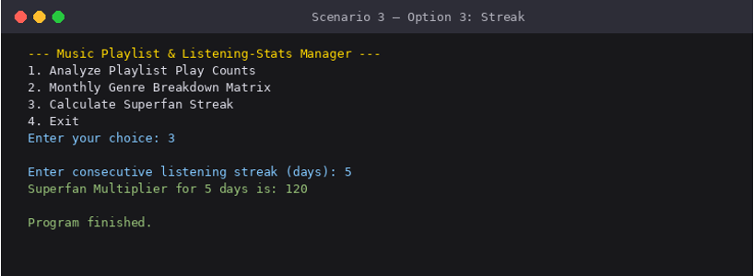
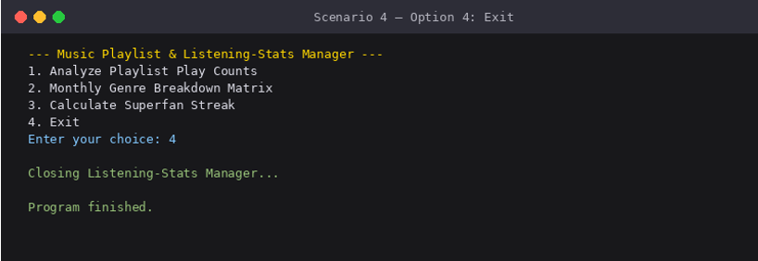
09 / 15 — OUTPUT (PART 2 OF 2)
Program Output — Superfan Streak & Exit
Scenario 3 invokes the recursive streak multiplier (5! = 120); Scenario 4 closes the app cleanly.
✦
Scenario 3
✦
Scenario 4
⏻
Clean exit
03 — SCENARIO 3 (Option 3)
04 — SCENARIO 4 (Option 4)
Option 3 — streak 5 days → Superfan Multiplier = 120 (5! = 120)
Option 4 — "Closing Listening-Stats Manager..." + Program finished.
♫
Music Playlist & Listening Stats Manager
12 / 15
Notes:
• Scenario 3 — user enters 5 days; calculateStreakMultiplier(5) recurses to return 120.
• Explain that 5! = 5×4×3×2×1 = 120 — a factorial, the "Superfan Multiplier".
• Mention how the base case (days == 0 → return 1) stops the recursion cleanly.
• Scenario 4 — Option 4 prints "Closing Listening-Stats Manager..." and exits.
• All four scenarios end with "Program finished." confirming Scanner.close() ran.

Slide 13



10 / 15 — FUTURE SCOPE
Where It Goes Next
A roadmap of five enhancements that take this console app toward a full music management suite.
01
02
03
04
05
PERSISTENCE
GUI
AUDIO
CLOUD
AI
File-backed Storage
JavaFX Desktop UI
Real Audio Playback
Cloud Sync & Sharing
Smart Recommendations
Save and load playlists to a CSV or JSON file so data survives between runs using java.io and the Jackson library.
Replace the console menu with a JavaFX window featuring tables, buttons, and visual equalizer bars — full desktop app experience.
Integrate JavaFX Media or JLayer to play actual MP3 files instead of just simulating play and incrementing a counter.
Sync playlists to a Firebase or REST backend so the same library follows the user across devices and can be shared with friends.
Recommend songs based on listening history using a collaborative-filtering model served from a Python backend.
MUSIC PLAYLIST & LISTENING STATS MANAGER
13 / 15
Notes:
- Persistence (phase 01) is the most natural next step — file-backed storage.
- GUI (phase 02) is the visual upgrade to a JavaFX desktop app.
- Audio (phase 03) replaces simulated play with real MP3 playback.
- Cloud (phase 04) brings cross-device sync and sharing.
- AI (phase 05) is the long-term vision — personalized recommendations.

Slide 14



11 / 15 — CONCLUSION
Wrapping Up
The Music Playlist and Listening Stats Manager demonstrates that a well-structured Java application — built with nothing but the standard library and a clear OOP design — can deliver a genuinely useful music management experience. By modelling songs and playlists as objects and tracking every play, the project turns passive listening into measurable, queryable data that the user controls.
10
24
2
CORE MENU FUNCTIONS
SIMULATED PLAY EVENTS
MODEL CLASSES (SONG, PLAYLIST)
KEY TAKEAWAYS
● Clean OOP — Song and Playlist classes encapsulate data and behaviour, keeping the manager thin.
● Real Analytics — Per-playlist + global stats computed on demand from in-memory state.
● Extensible — Single-file design is easy to extend with persistence, GUI, or audio playback.
Built in Java. Demoed live. Ready for GitHub.
MUSIC PLAYLIST & LISTENING STATS MANAGER
14 / 15
Notes:
- Restate the project's value in one sentence — clean Java OOP delivering useful music analytics.
- Call out the three stats: 10 functions, 24 play events, 2 model classes.
- Emphasize extensibility — persistence, GUI, audio are easy next steps.
- Thank the audience and transition to the Thank You slide.

Slide 15

♪
♫
END OF PRESENTATION
Thank You
♪
Questions & Discussion
♩
JAVA
OOP
CONSOLE APP
PROJECT
SUBJECT CODE
Music Playlist & Listening Stats Manager
26SC1101E
]
PRESS 0 IN THE APP TO EXIT • BUILT WITH OPENJDK 21
Notes:
- Thank the professor and audience for their attention.
- Invite questions and discussion.
- Mention the source code is available on GitHub.
- Acknowledge the faculty guide by name.

